Slide 1
Red Card System: Guideline (Aaron)

Slide 2
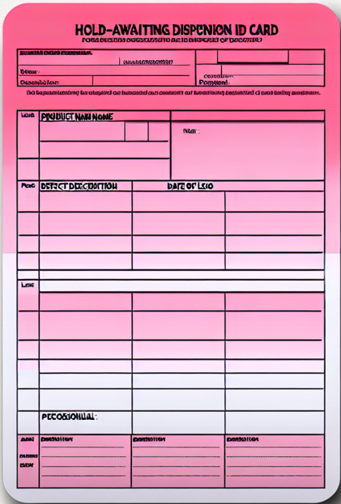





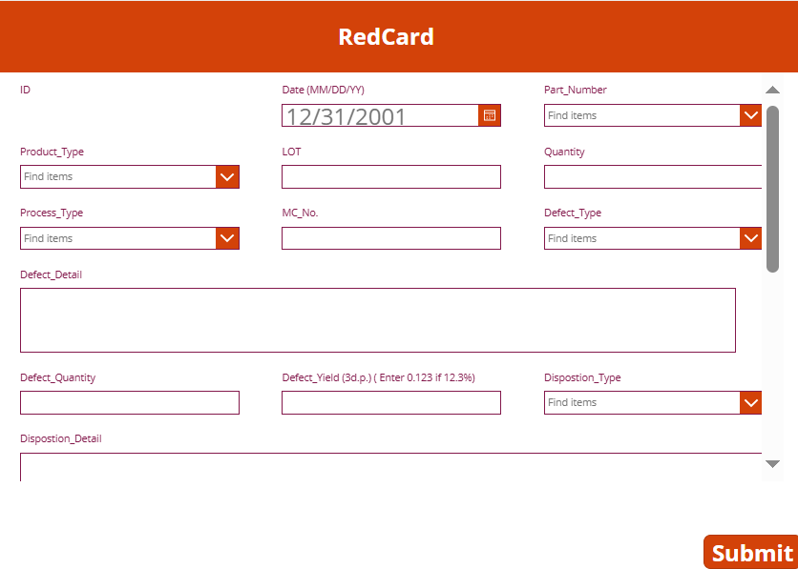
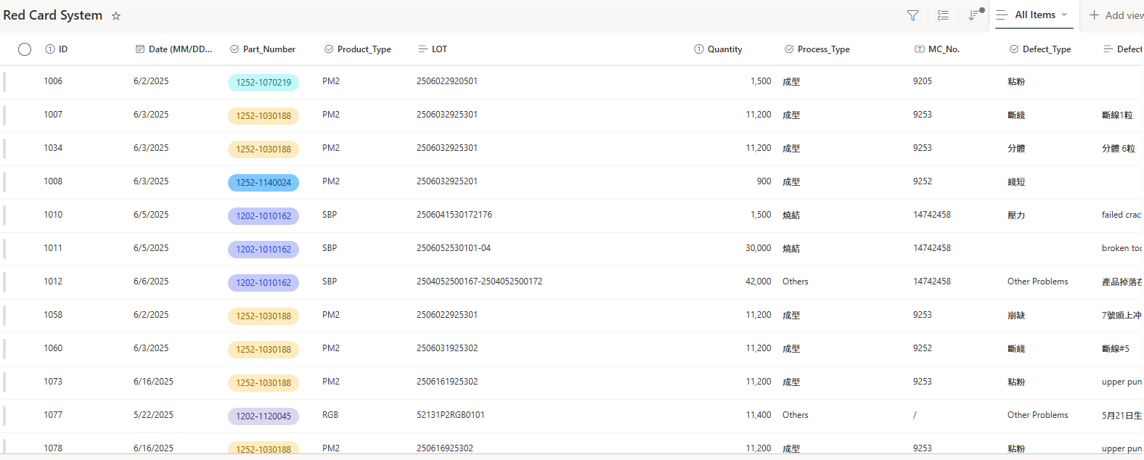
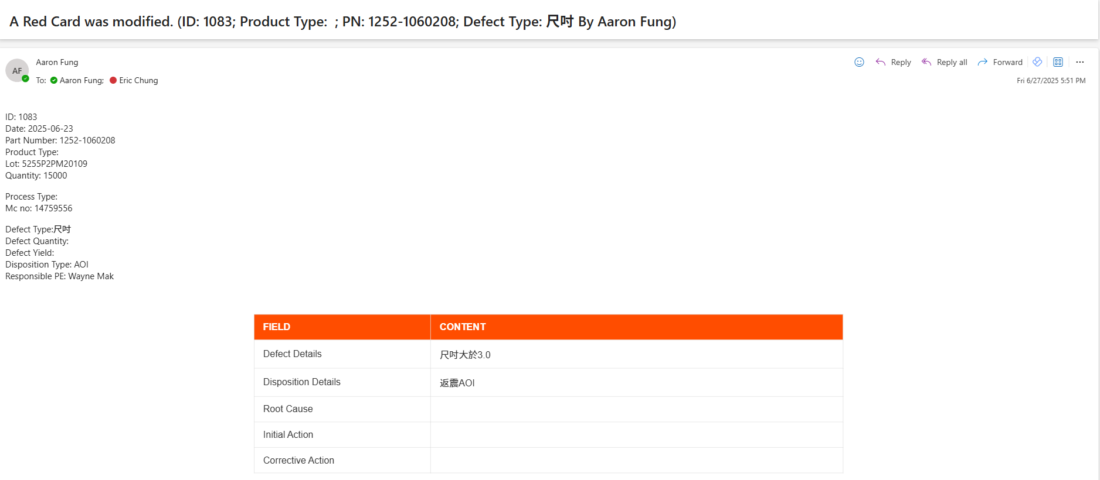
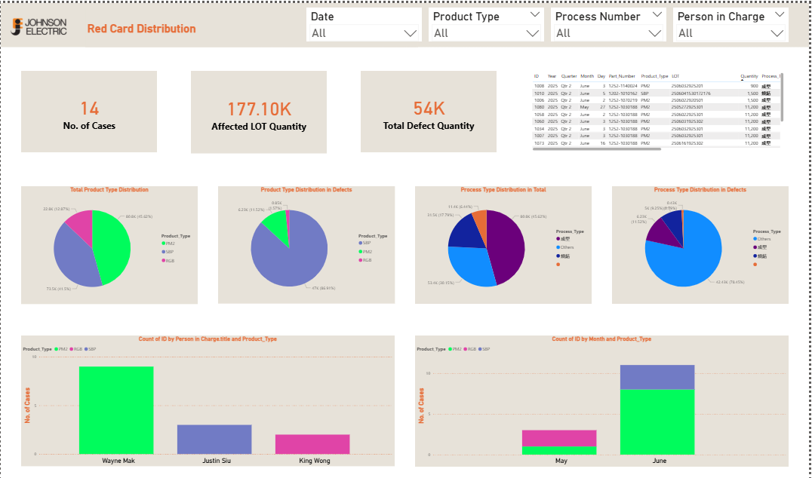
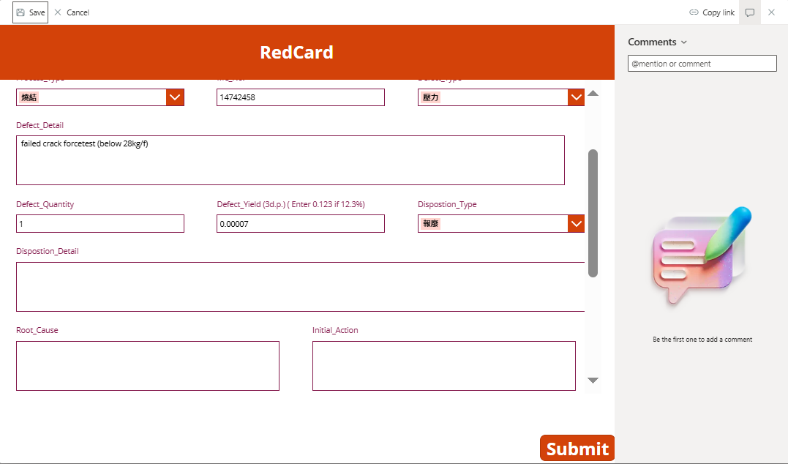
What is the Red Card System?
No. | Project Name | Objective | Result | Methodology
1 | Red Card System | - Transform manual defect tracking to digital system - Implement automated workflow notifications - Ensure data integrity and real-time visibility | - Eliminated manual data entry errors - Real-time defect status tracking - Automated engineer notifications - Enhanced data security with audit trails | - Upload data to SharePoint via Power Apps - Implement Power Automate alerts - Two-stage process: Paper → Digital → Engineers - Power BI replaces operator reporting
1️⃣ Daily operation :
Power Apps
SharePoint
Power Automate
Power BI
Multiple defect incidents occurred.
Record defects on paper red cards by Operators.
Upload data to SharePoint via Power Apps.
Automate email alerts with Power Automate.
Visualize defect trends in Power BI.
2️⃣ Engineers double checking :
Power Apps
SharePoint
Power Automate
Update forms by Engineers.
Automate email alerts with Power Automate.

Slide 3
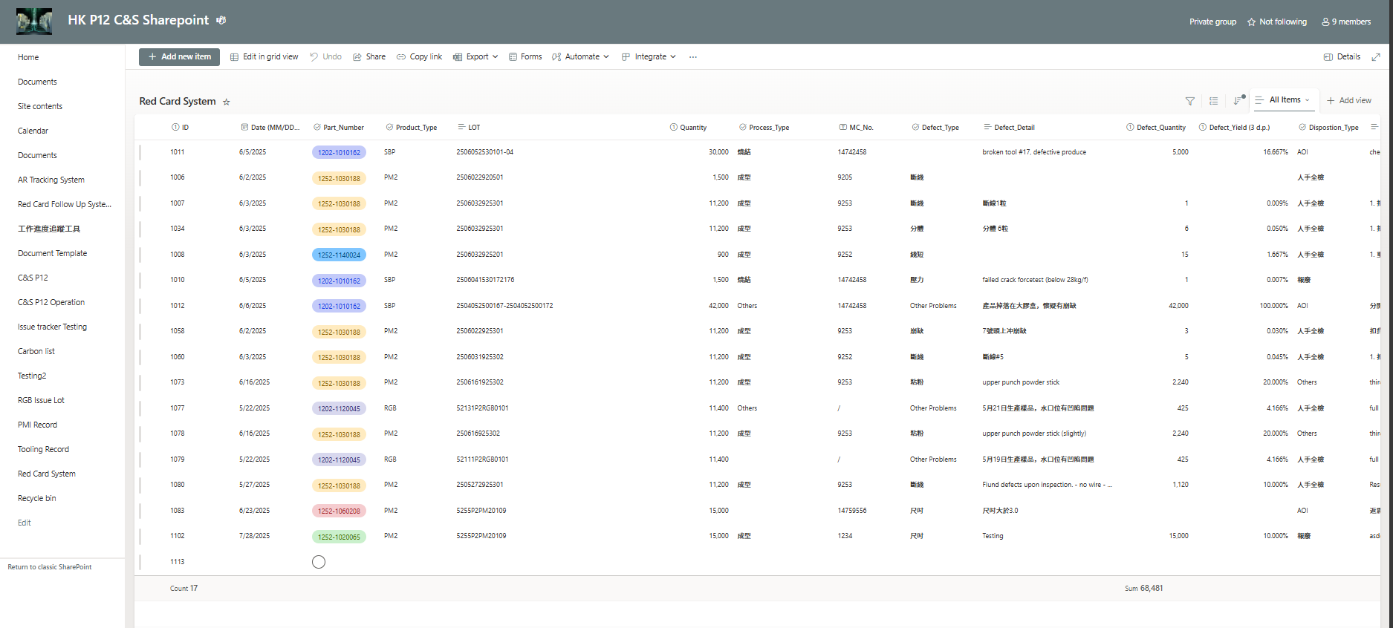
Operators : Step 1
In HK P12 C&S Sharepoint - Red Card System - All Items , click “Add new item”

Slide 4
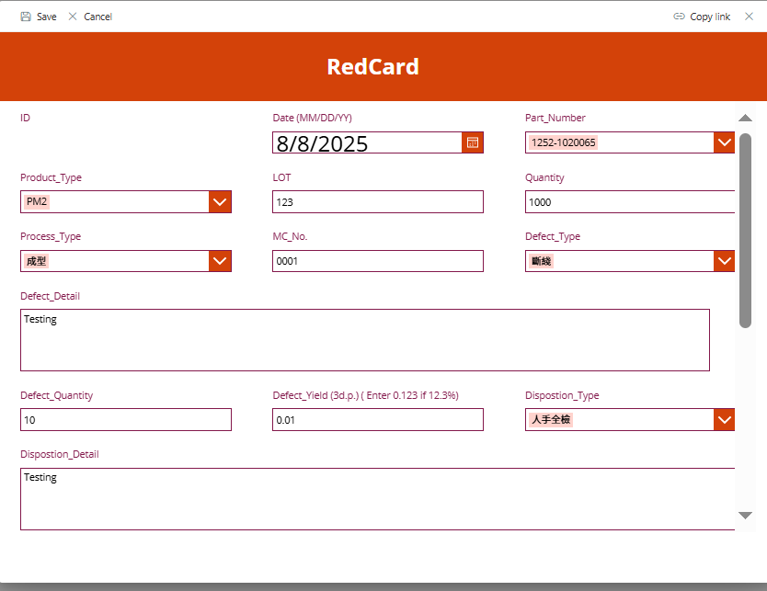
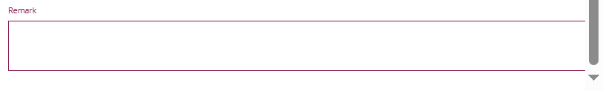
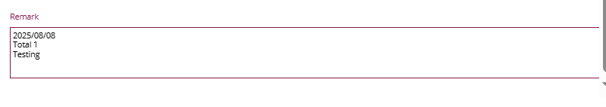
Operators : Step 2
Enter data. ( if there is any blank columns, please record in remark with today date, number of red cards, and problems.)

Slide 5
Operators : Step 3
1114
A new data row is now created. Record the ID of the data on Red Card on the top right corner.

Slide 6
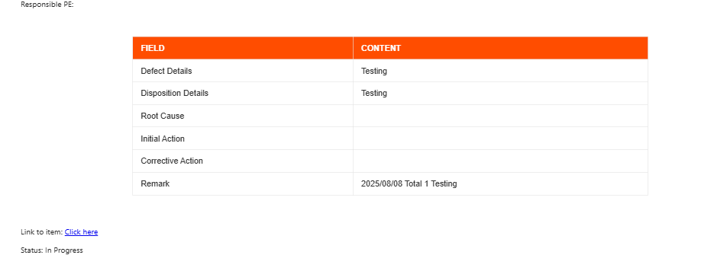
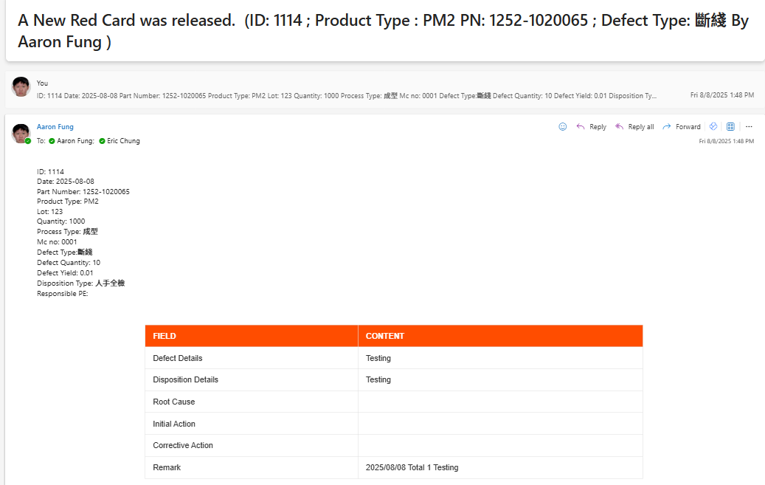
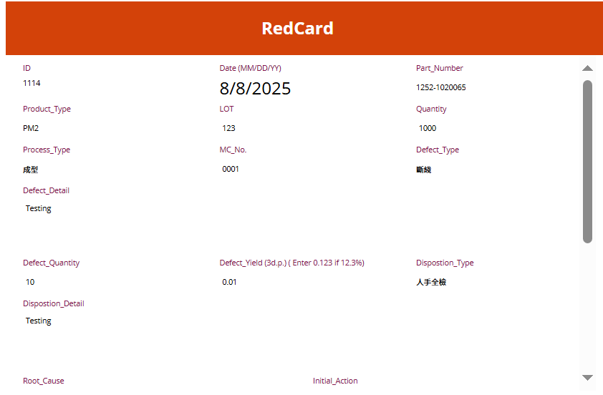
Engineers : Step 1
When engineers receive an email of a new red card, click “Click here” to the following item properties of following data.

Slide 7
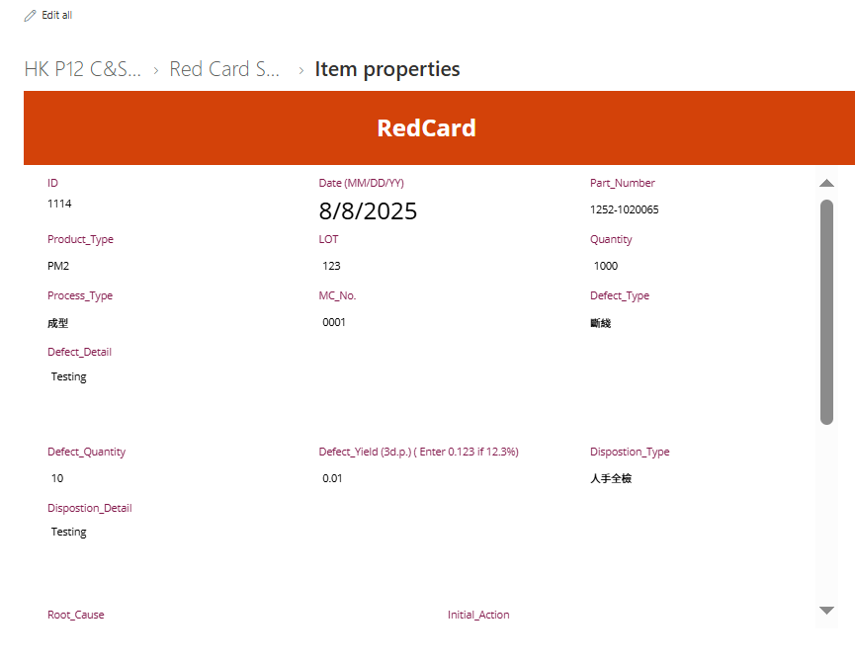
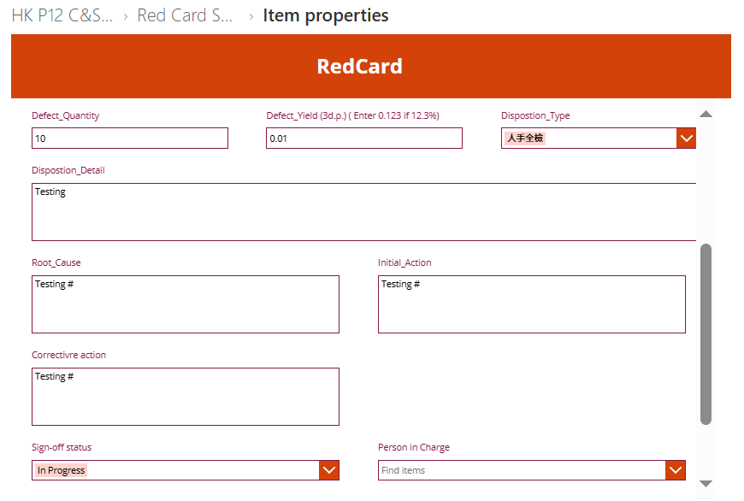
Engineers : Step 2
Click “Edit all” for additional information after evaluating the incident. It is suggested to record on remark if there is any problems.

Slide 8
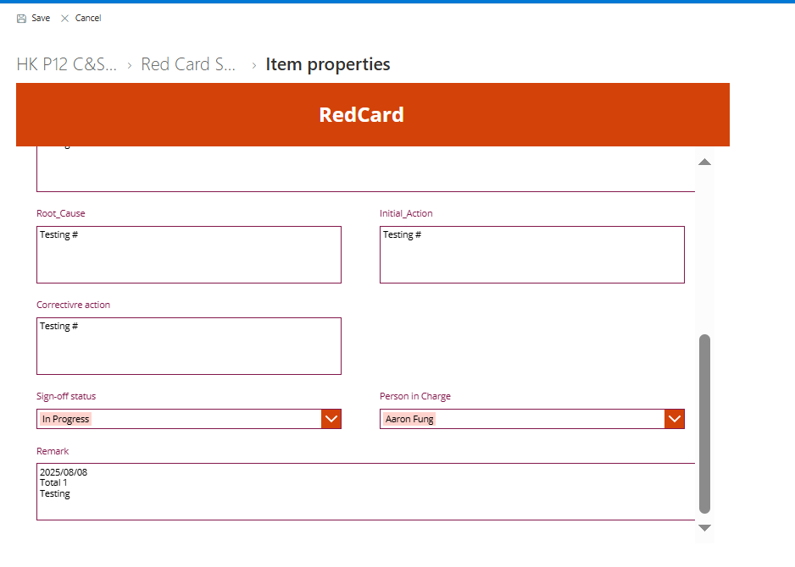

Engineers : Step 2
Change “Sign-off status” to “Complete” and click “Save”. Done

Slide 9
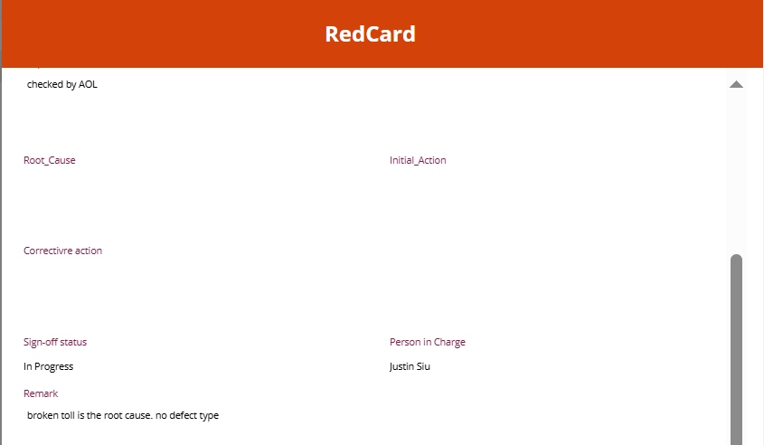
Remarks (What to Pay Attention To)
1️⃣ Record ID on the top right corner of the Red Card
2️⃣ Remark for any missing info.
1008

